Slide 1

Fertilizer Recommendation System
Group Members:
Jawad Khan (19P-0053)
Muhammad Usman (19P-0116)
Project Supervisor:
Mr. Usman Wajid

Slide 2
Introduction
Agriculture is a important sector for any economy, and its success is crucial to ensuring food security and economic stability. However, the sector faces several challenges:
Inefficient use of fertilizers
Selecting best suitable crop based on the collected data

Slide 3
Problem Statement
The current agricultural sector faces various challenges such as inefficient use of fertilizers, optimal crop selection and lack of crop remote monitoring mechanisms.

Slide 4
Proposed System

Slide 5
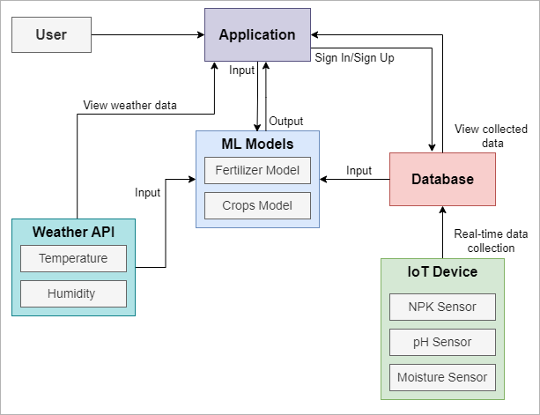
Architecture
Design

Slide 6
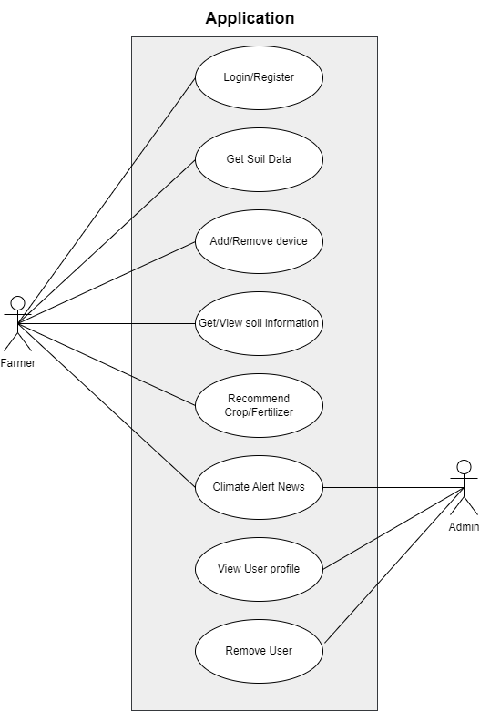
Use Case Diagram

Slide 7
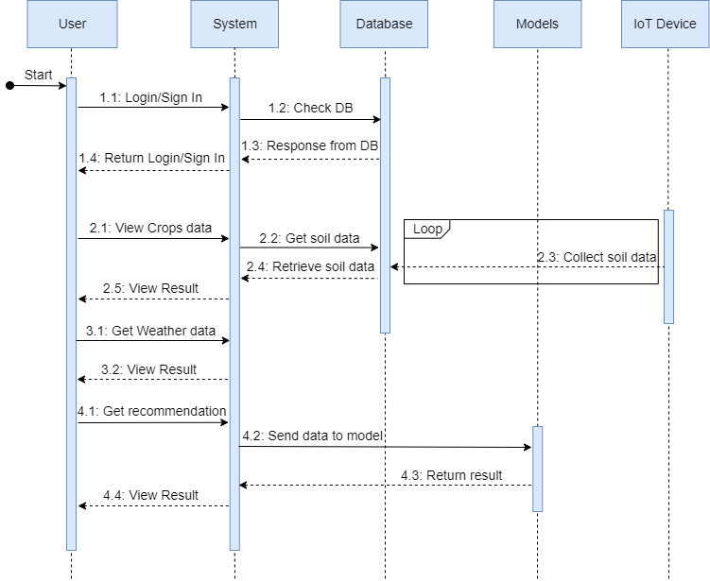
Sequence
Diagram

Slide 8
IoT Device components
The following are the things that are required:
Arduino UNO
NodeMCU(wifi module)
NPK sensor
MAX485 (transceiver)
Moisture sensor
Soil pH sensor

Slide 9
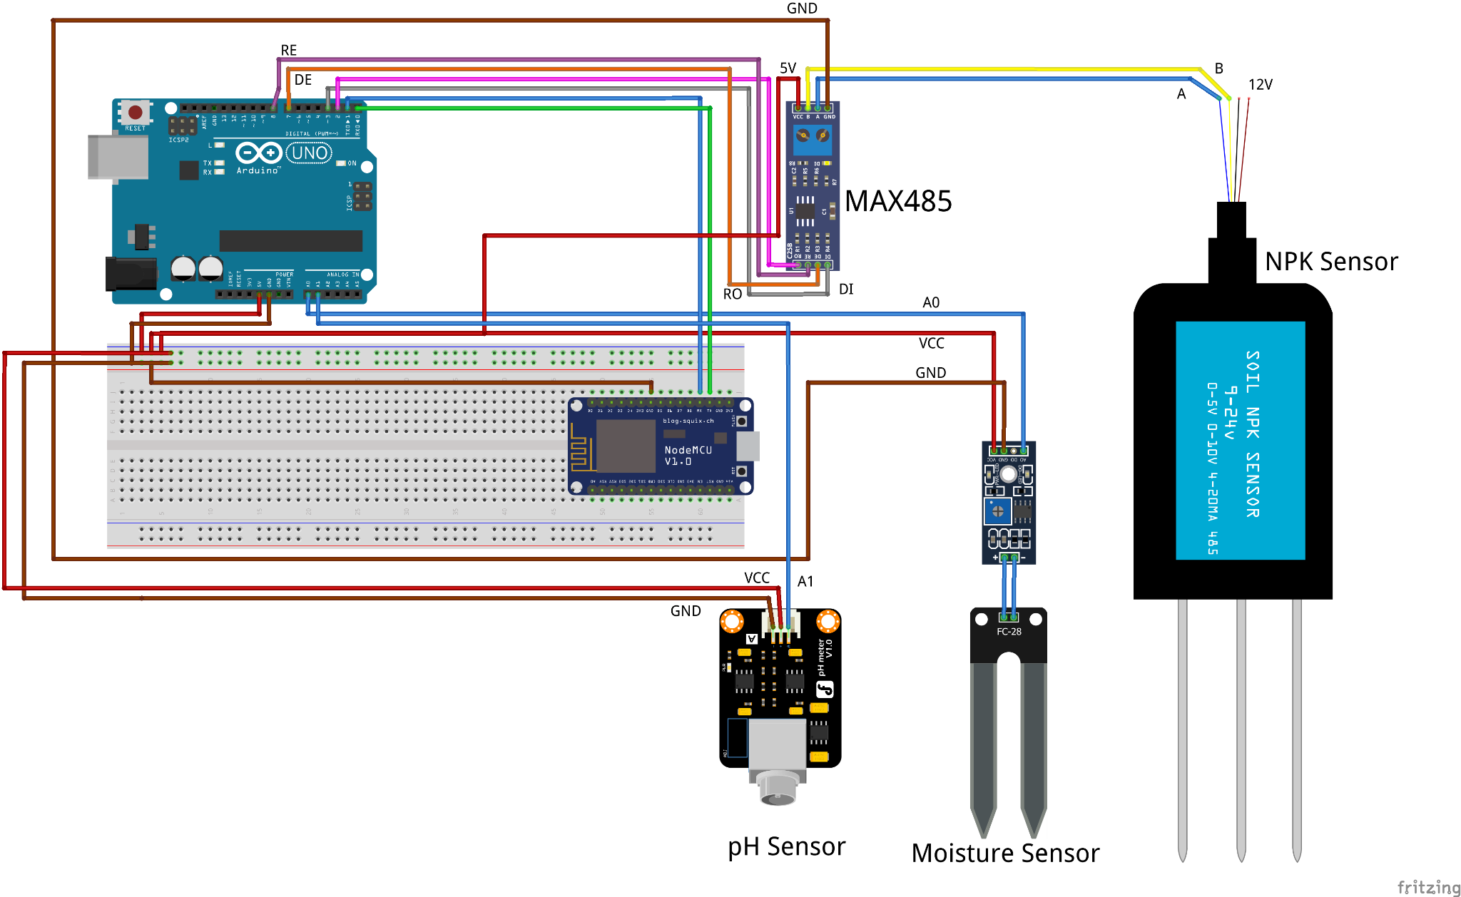
IoT Device

Slide 10

Database
User Authentication modules.
NoSQL (json) based database.
Using Firebase because of the real-time feature maintains history as well.

Slide 11
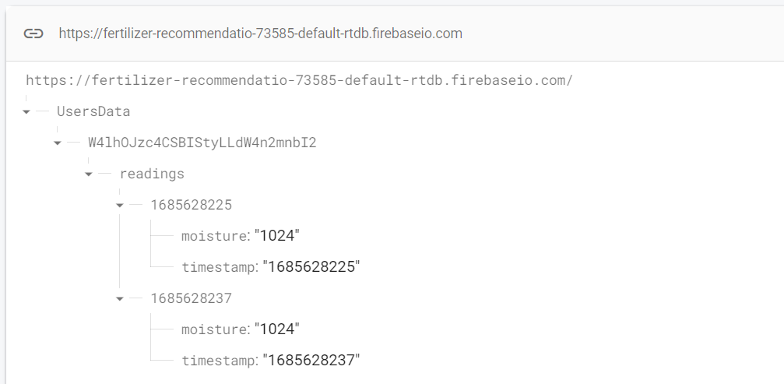
Real-Time data collection

Slide 12
IoT Device Code

Slide 13
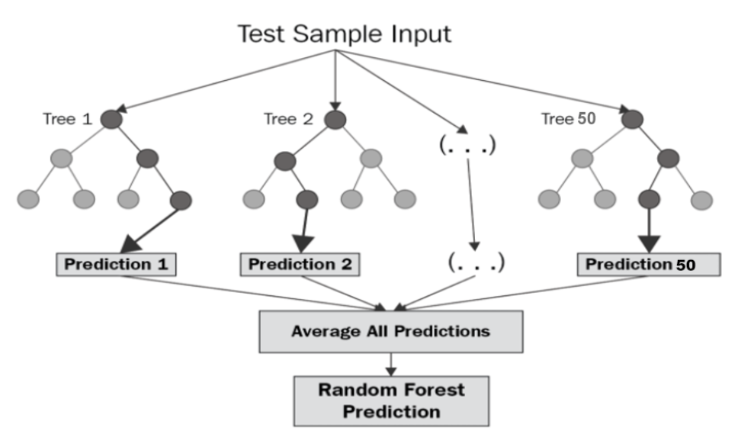
Implementation Algorithm
Random Forest Regression

Slide 14
Data Description
Input Features:
Crop: Rice, Cotton, Apple (Total 22).
Temperature: Temperature in degree Celsius
Humidity: Relative humidity in percentage
Rainfall : Rainfall (mm)
Output Label:
Label_N : Ratio of Nitrogen content in soil
Label_P : Ratio of Phosphorus content in soil
Label_K : Ratio of Potassium content in soil

Slide 15
Random Forest Regression
BEGIN
Step 1 : Split the dataset n=2200 into training and test dataset (Where training set is 80% and test set is 20% that is training set=1,760 and test set=240).
Step 2: Apply random forest regression to each N, P and K (Nitrogen, Phosphorus & Potassium) value with n_estimators=50 (n_estimators is the number of decision tree).
Step 3: Train N_label, P_Label and K_Label with the training dataset and dependent variable (Where dependent variable is N for N_Label, P for P_Label and K for K_Label).
Step 4: Each N_Label, P_Label and K_Label generates a 50 decision tree as an output based on training dataset.
END

Slide 16
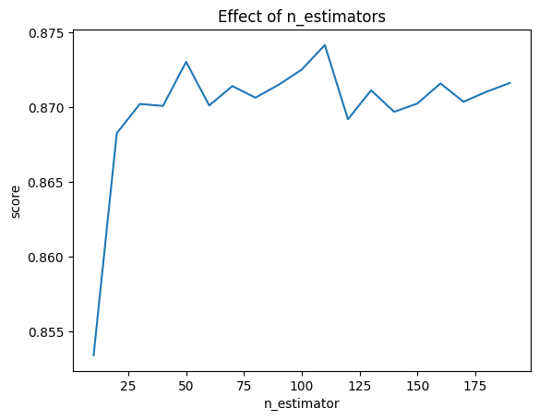
ML Results

Slide 17
Website Demo

Slide 18
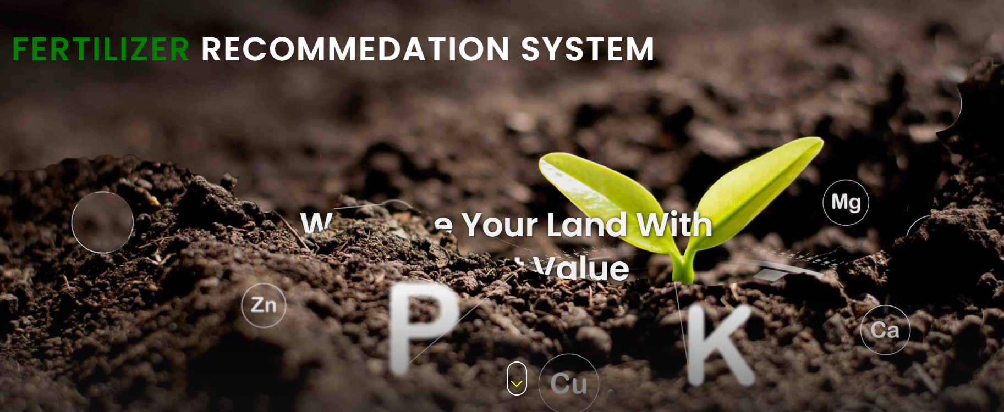

Slide 19
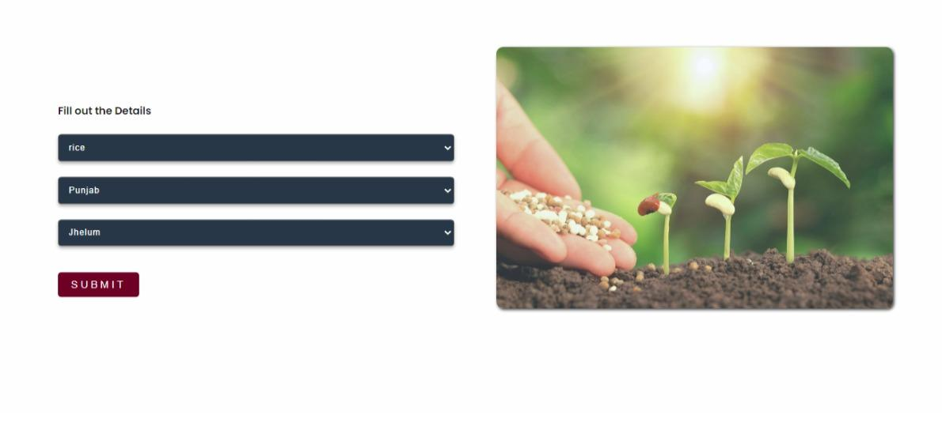

Slide 20
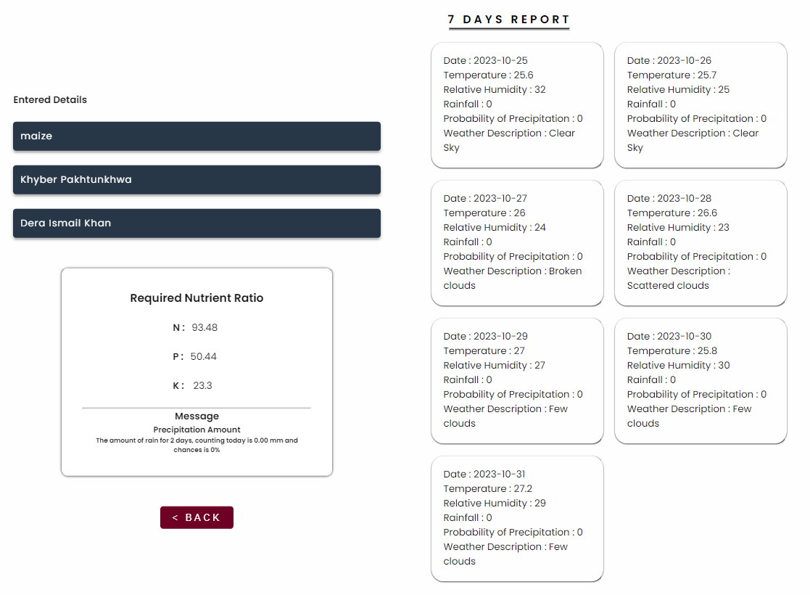

Slide 21
Demo App

Slide 22
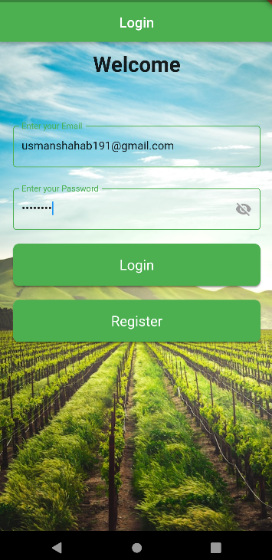
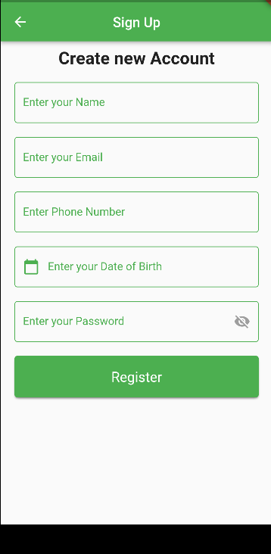
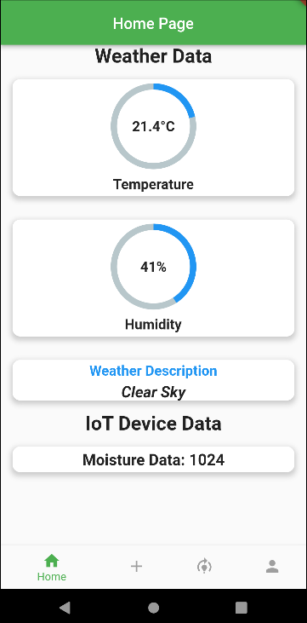

Slide 23
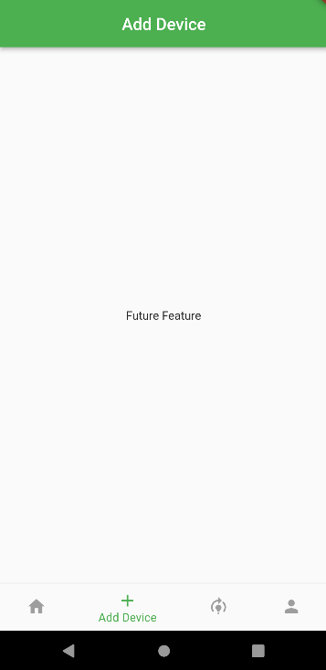
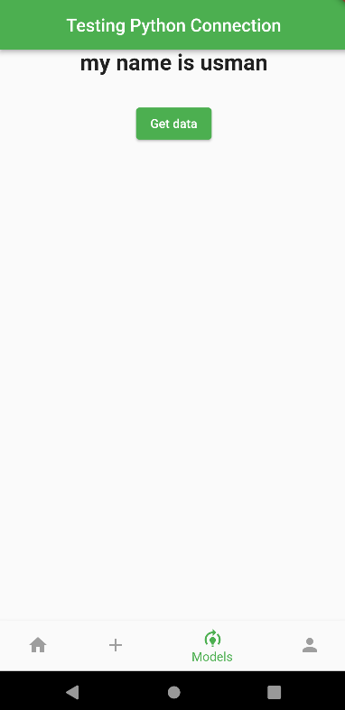
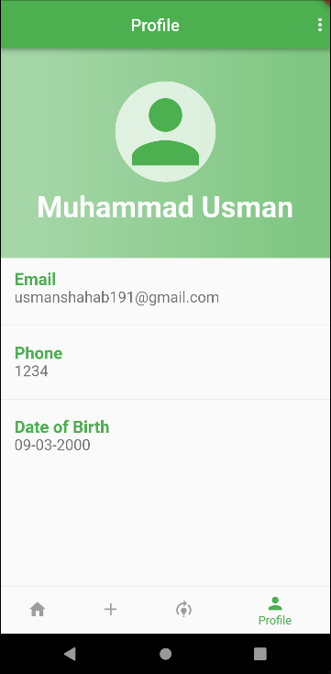

Slide 24
Timeline (FYP - I)
February
March
April
May
W1
W2
W3
W4
W1
W2
W3
W4
W1
W2
W3
W4
W1
W2
W3
W4
Creating Use case, UML, Activity diagram etc
Literature Review
Creating dataset for fertilizer
Creating the model
Soil data Integration into App
Demo App(Login/Register, Weather API , and connection with Flask server )
Basic IoT device connections

Slide 25
Timeline (FYP - II)
September
October
November
December
W1
W2
W3
W4
W1
W2
W3
W4
W1
W2
W3
W4
W1
W2
W3
W4
App Development
Making IoT device
IoT Device Features (Add\Remove sensors)
Models Integration
Testing and Debugging
Optimization
Deployment of the App
Documentation

